Slide 1
Development of High-Order Discontinuous Galerkin Method Within OpenFOAM
Liyang Xu¹, Xinhai Xu², Xuefeng Yuan³, Xiaoguang Ren², Shuai Ye¹
¹State key Laboratory of High Performance Computing,
NUDT, Changsha, China
²Innovation Institute for Defence Science and Technology, the Academy of Military Science (AMS), China
³Advanced Institute of Engineering Science for Intelligent Manufacturing, Guangzhou University, China
Email: HopeFOAM@163.com
2017/07/24
Notes:
Hello everyone, today I am gona show you our work, the development of high order discontinuous galerkin method within openfoam.

Slide 2
Outline
Motivation for high order schemes
Basic principles of DG-FEM
Implementation within OpenFOAM
design philosophy and framework
user interfaces
support of curved mesh
Preliminary results
Future work
Notes:
This report mainly contains five part. Firstly, gets look at the motivation for high order schemes

Slide 3
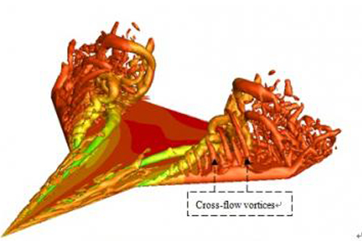
Motivation
Complex realistic problem simulation
Wake and vortex flows
LES/DNS
Other Challenges
Complex geometries
Multi physics and many scales
Notes:
For realistic problems, the industrial applications especially, is very complicate and hard mainly caused by turbulence. Here are images of airfoil and delta wing. Wake and vortex flow will generate from the surface when flow past the geometries. To simulate these problem, we need LES or DNS method. Other challenges such as complex geometries, multi physics and many scales.
In the simulation of these problems, the mesh need to be very dense to obtain satisfied results. However, the computational cost will increase dramatically.

Slide 4
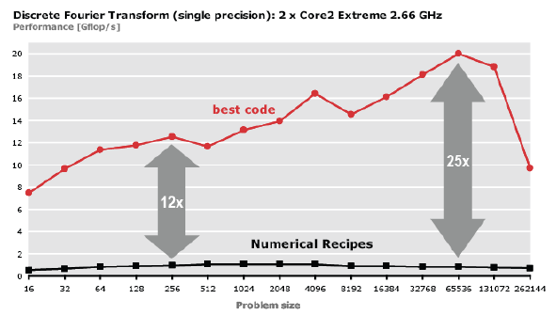
Motivation
2nd order accuracy may not be enough
much more points to achieve given accuracy
limitation of computation cost and scalability
Require advanced numerical methods
high performance, high scalability and high-order accuracy
Notes:
Nowadays, finite volume is the most popular method in Computational fluid dynamics. But in some circumstances, the 2nd order accuracy may not be enough. In complex problems, we need much more points to achieve given accuracy comparing to high order methods. At the edge of Moore's law about to come to its end, we tend to use multi-core and parallel program to get higher computation ability. But this is very hard. For larger problem, we need more processors. Due to the limitation of scalability, it is not practical to get idea parallel efficiency. It may even be slower with more processors because the communication overhead.
So, we are looking for advanced numerical methods, which are high performance, high scalability and high order accuracy especially.

Slide 5
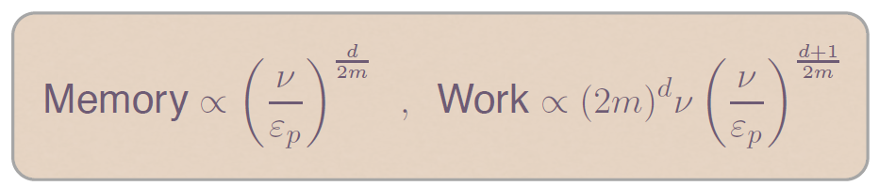
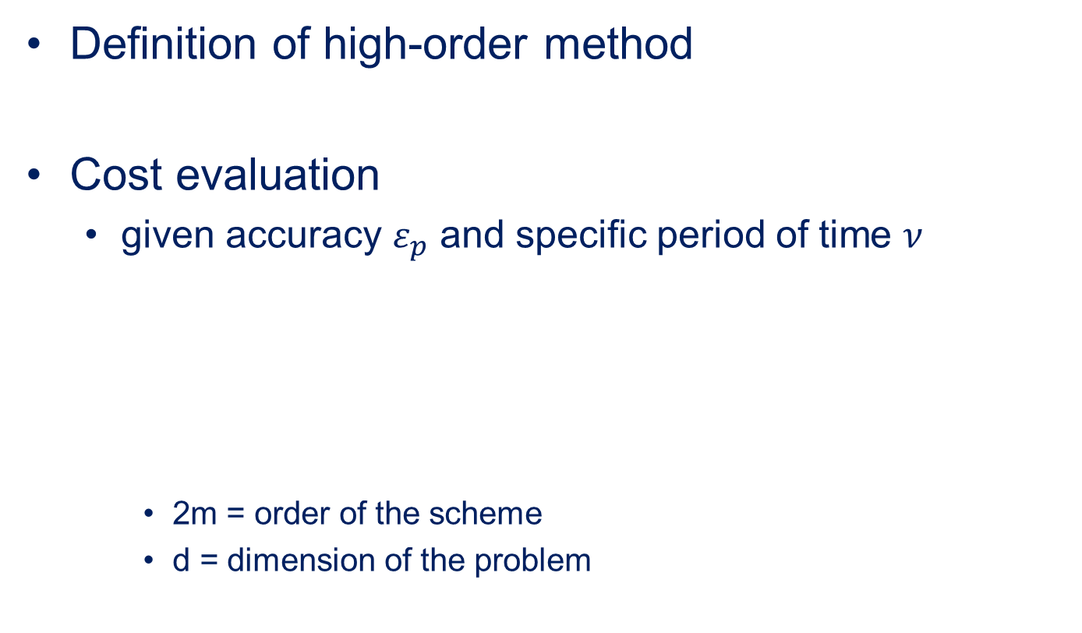
Motivation
Definition of high-order method
Cost evaluation
given accuracy $ε_{p}$ and specific period of time $ν$
2m = order of the scheme
d = dimension of the problem
truncation order > 2
Notes:
We define the high order methods are those with truncation order higher than 2rd order.
Here are the approximate cost evaluation equation illustrates relation between memory and cpu cost with order, dimension and given error limit.
For a critical case ,and the error limit, dimension, and accuracy order set. Let us analysis the cpu costs. For cases with high accuracy required, the second term is much larger than the first term and will the majority. With the order in the denominator分母 of exponent指数.
So, the overall overhead will drop dramatically when using high order.

Slide 6
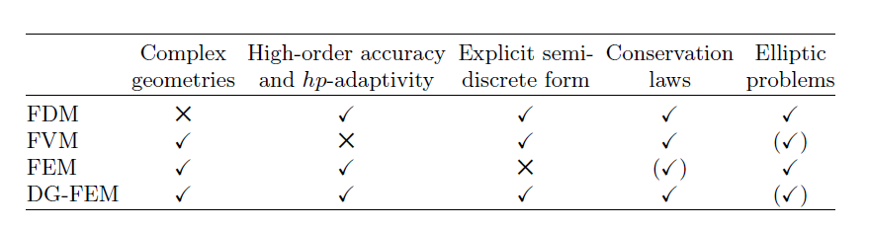
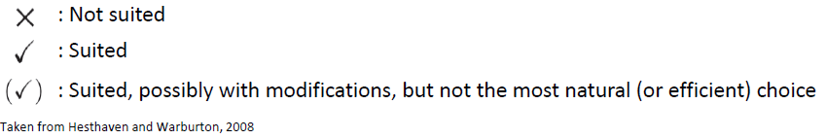
Motivation
Comparison of common methods
DG-FEM = FVM + FEM
Notes:
Here are the comparison of common differencing methods taken from Heathevan and Warboton’s book, including FDM, FVM, FEM and DG. The tick means suited while a cross means not suited. Here we have 5 criterion, including complex geometries, high order accuracy and hp-adaptivity, Explicit semi-discrdte form, conservation laws and elliptic problems. FDM , we can see, not suits for complex geometries but good at other 4 criterion. The FVM is hard to achieve high order accuracy, while FEM fail in explicit semi-discrete form. DG is a combination of FVM and FEM, and inherits their advantages in discretization. For this reason, we choose DG as the ideal approach.

Slide 7

Motivation
High-order methods are hard to implement and use
DG is flexible (unstructured grid)
Organization of DG is similar to FVM
OpenFOAM
2nd FVM
well designed framework and user interface
excellent tool chain
Bring DG to

Slide 8









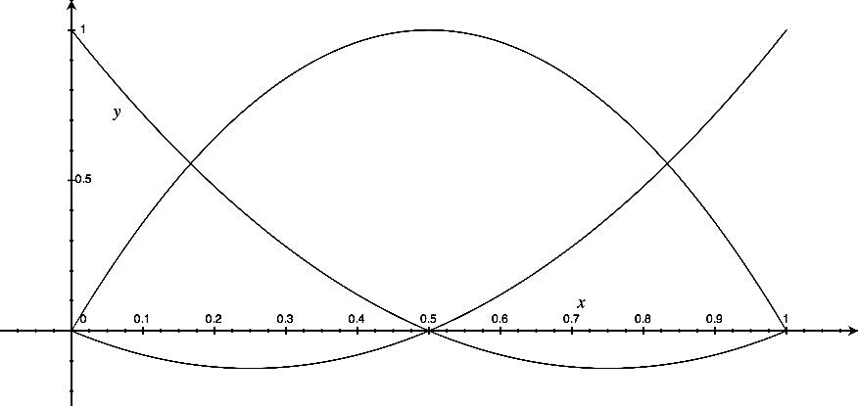

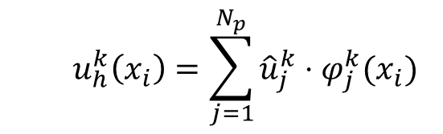
Basic principles of DG-FEM
Nodal DG-FEM
Piece-wise polynomial
Element k:
$φ_{j}^{k}(x_{i})$—basis function
${\hat{u}}_{j}^{k}$ -- nodal value of field $u$
$N_{p}$ -- number of basis points
$$u_{h}^{k}\left(x_{i}\right)=\sum_{j=1}^{N_{p}}{{\hat{u}}_{j}^{k}⋅φ_{j}^{k}(x_{i})}$$
Face
……
……
Element
Notes:
Continuous function represented by piece-wise polynomials. Each cell is represented separately.
The neighboring cells are not indeed separate, they are combined by flux.

Slide 9

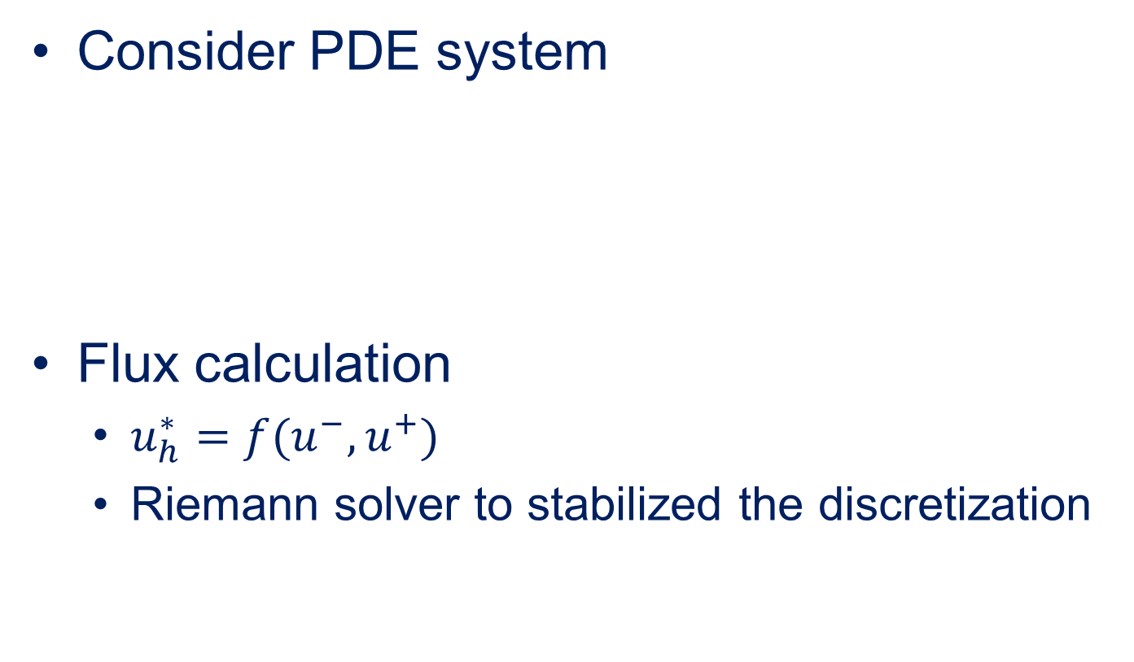

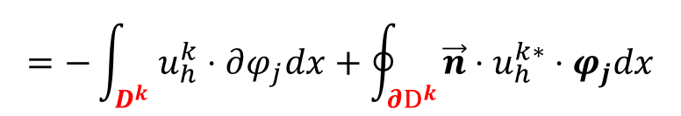
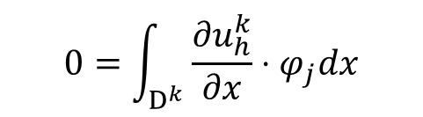
Basic principles of DG-FEM
Consider PDE system
Flux calculation
$u_{h}^{∗}=f(u^{−},u^{+})$
Riemann solver to stabilized the discretization
$$0=\int_{D^{k}}{\frac{{∂u}_{h}^{k}}{∂x}⋅φ_{j}dx}$$
$$=−\int_{D^{k}}{u_{h}^{k}⋅∂φ_{j}dx}+\oint_{∂D^{k}}{\vec{n}⋅u_{h}^{k∗}⋅φ_{j}dx}$$
Cell Integration
Face Integration
$${\hat{u}}_{h}^{k+}$$
$${\hat{u}}_{h}^{k−}$$
Notes:
Let’s consider a PDE system.
Solution at the interfaces is multiply defined and discontinuous
With this constraints, the whole computational domain forms a linear system.

Slide 10
Design principle and framework
User Interface
DSL(fvm::div(phi, u)==0)
Control Dictionary
fvMesh
fvPatch
volScalarField
volVectorField
……
fvPatchField
fvMatrix
FVM Related
Data and Methods
Fvm::div
Fvm::grad
Fvm::laplacian
Fvc::div
Fvc::grad
polyMesh
polyPatch
GeometricField
dimensionedField
lduMatrix
OpenFOAM Basic
Data Structure
Point
Face
Cell
Scalar
Vector
Tensor
Scalar
Vector
Tensor
Notes:
Next I will talk about how we design the DG with OpenFOAM and out framework.
In my understanding, OpenOAM mayinly have 3 levels. The bottom is basic data structure.
The middle level is the finite Volume related data structure and methods.
The top level is user interfaces and other physical models. The user interface refers to DSL and control dictionary.

Slide 11
Design philosophy and framework
Design philosophy
Reuse the framework and data structure
Keep consistent with the user interface
Inherit the pre and post processing tools
Add a separate DG source package
High order DG discretization
High performance
High extensibility, runtime selection

Slide 12
Design principle and framework
User Interface
DSL(dgm::div(u, u)=0)
Control Dict
DG tools
Limiters
Flux Calc Schemes
hp Controlers
DG Related
Methods
Boundary Conditions
dgc/dgm
Schemes
Matrix
Solvers
Interfaces
DG Discretization
Kernel
Nodal Base
dgMesh
dgField
dgMatrix
OpenFOAM Basic
Data Structure
Scalar
Vector
Tensor
Point
Face
Cell
polyMesh
polyPatch
GeometricField
dimensionedField
External Libs
PETSc
BLAS
SLEPC
Metis
Scotch
VTK
Notes:
We add a separate level called DG discretization kernel.
We rewrite the DG related methods

Slide 13
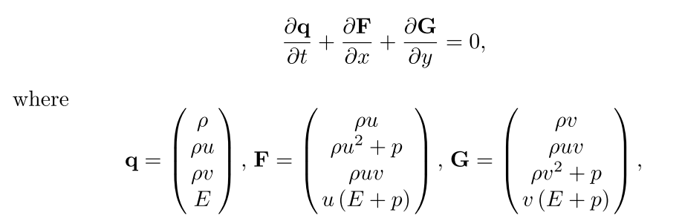
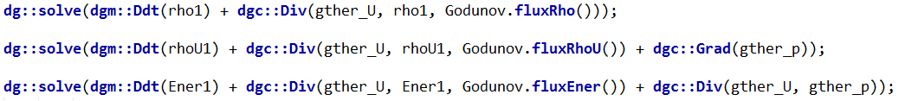
User interfaces
DSL in DG (Euler equation)

Slide 14
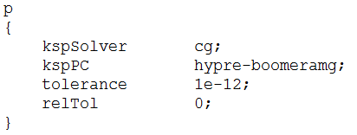
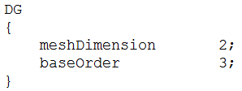
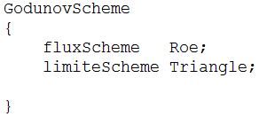
User interfaces
Control dictionary
system/controlDict, system/decomposeParDict
nearly the same with original OFM
system/dgSolution
system/dgSchemes

Slide 15
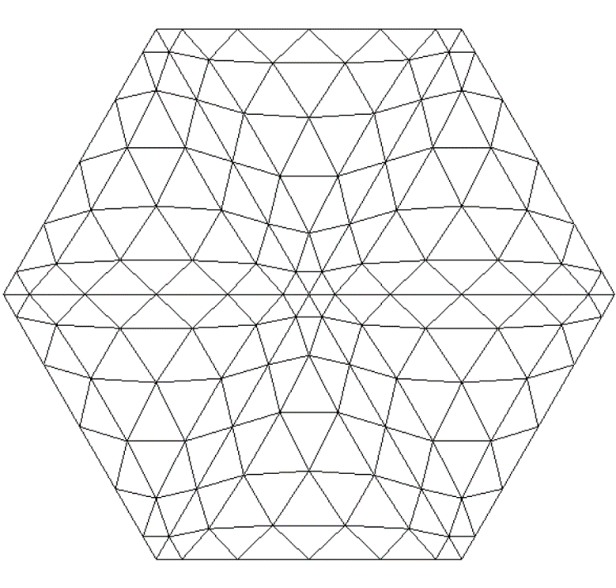
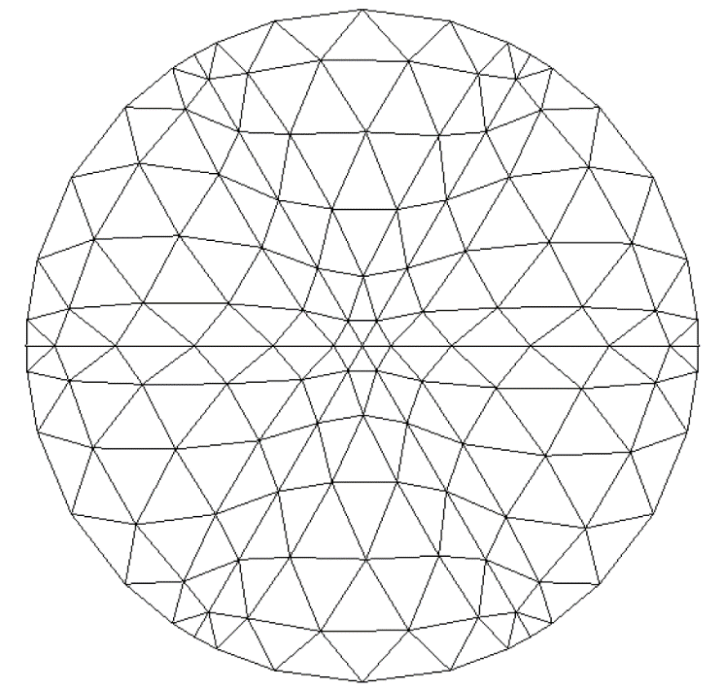
Support of curved mesh
Curved mesh is critical to achieve high order convergence rate
6 cells cavity with 6th basis
Notes:
Wo also provide support to curved mesh. Bassi Proved that curved mesh is critical to achieve high order convergence rate. For 2nd order method this won’t be a problem. Here is a example of curved mesh and straight side mesh.

Slide 16
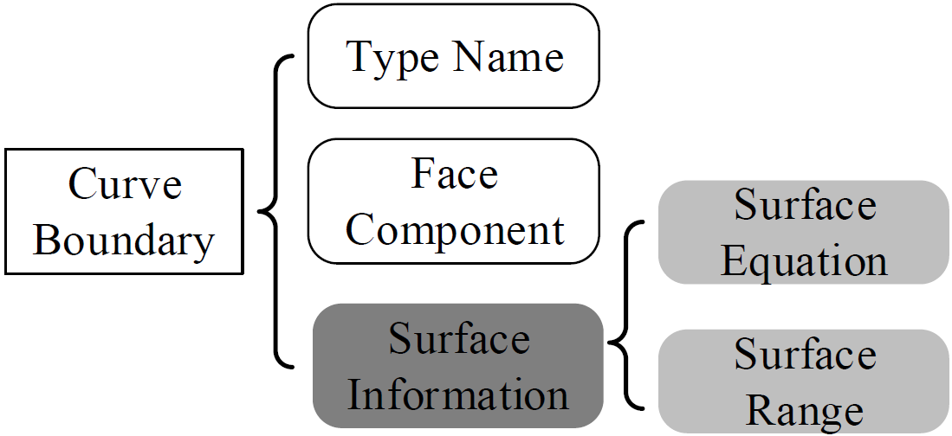
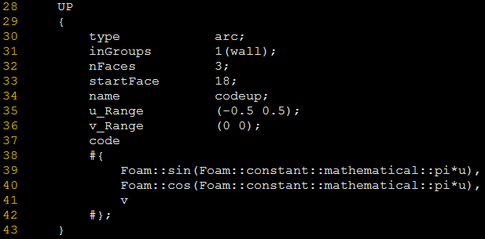
Support of curved mesh
Implementation and configuration
based on codeStream

Slide 17
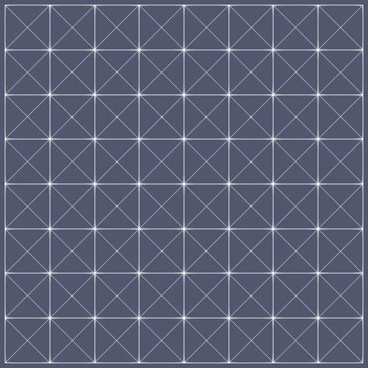
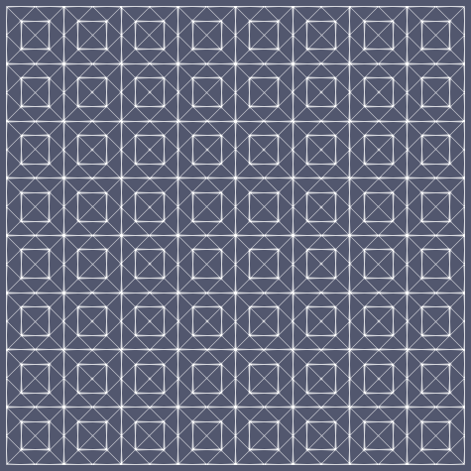
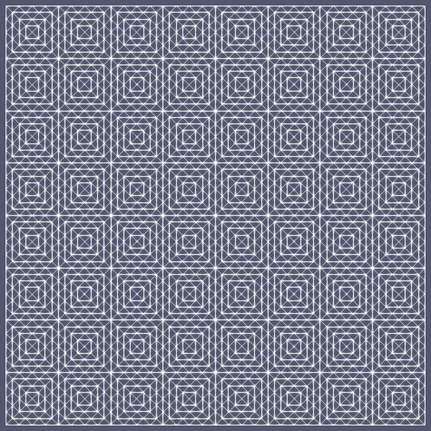
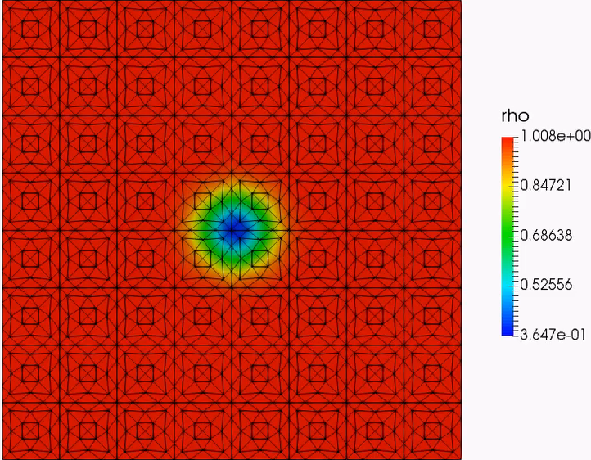
Preliminary results
Isentropic vortex problem, inviscid
h (256) h/2 (1024) h/4 (2028)
Results with 256 cells and 3rd basis
High order post processing

Slide 18
Preliminary results
Convergence order test
Euler solver with Roe flux
N | Error in ρ |  |  |  | Error in ρu
 | h | h/2 | h/4 | Rate | h | h/2 | h/4 | Rate
1 | 1.101E-02 | 3.344E-03 | 8.759E-04 | 1.83 | 2.361E-02 | 7.182E-03 | 1.793E-03 | 1.86
2 | 3.481E-03 | 3.621E-04 | 3.972E-05 | 3.23 | 6.384E-03 | 8.060E-04 | 9.689E-05 | 3.02
3 | 6.523E-04 | 5.471E-05 | 3.173E-06 | 3.84 | 1.610E-03 | 1.226E-04 | 7.141E-06 | 3.91
4 | 2.352E-04 | 8.808E-06 | 3.690E-07 | 4.66 | 5.187E-04 | 1.866E-05 | 8.533E-07 | 4.62
5 | 6.597E-05 | 1.477E-06 | 5.505E-08 | 5.11 | 1.388E-04 | 2.695E-06 | 1.591E-07 | 4.88
6 | 2.530E-05 | 2.675E-07 | 1.232E-08 | 5.50 | 4.675E-05 | 4.760E-07 | 3.837E-08 | 5.13
OFM-FVM | 1.340E-02 | 7.209E-03 | 3.039E-03 | 1.07 | 3.466E-02 | 1.733E-02 | 6.945E-03 | 1.16
Notes:
This is the convergence order test results.
A popular misunderstanding about high order method is that it is computational expensive. Maybe under the same mesh, the high order methods is slower. but this comparison is not fair, because the high order methods obtain more accurate results. So, here we gonna to see the computational cost under the same error limit.

Slide 19
Preliminary results
Error-Cost test
Notes:
Compare OFM and DG N=1
Compare the slop factor with different N
Extend the line of FVM, when high accuracy is need, the FVM costs much more computation.

Slide 20
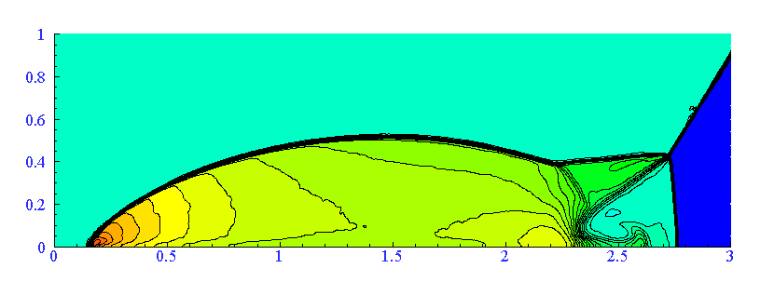
Preliminary results
Double Mach Problem, inviscid, 10 Ma
Euler solver with 1st order basis, LF flux and gradient limiter
To utilize high order basis, need high order limiter
Notes:
To test the ability of Dg to handle complicate problem.

Slide 21
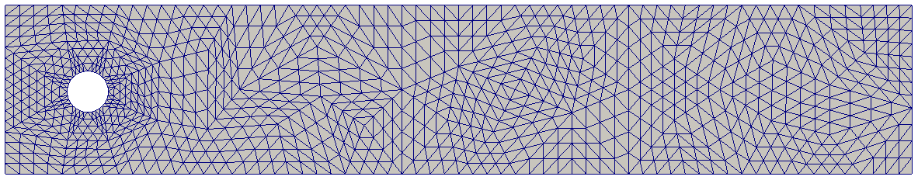
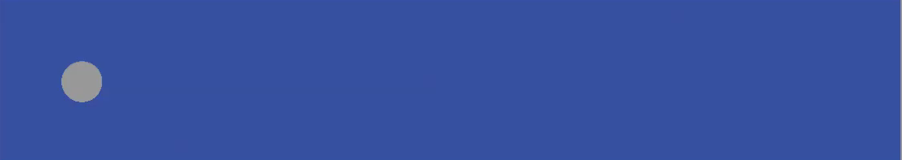
Preliminary results
Flow past cylinder, Re=100
INS solver with pressure projection method
1840 cells with 3rd basis
Curved mesh in cylinder patch

Slide 22
Future work
What already support
High order DG space discretization (up to 8)
OFM compatible user interface
Inviscid Euler & INS solver
High order curved mesh
To be developed
3D basis extension
hp adaption
High order limiter, shock capturing
LES models
Performance optimization

